Slide 1
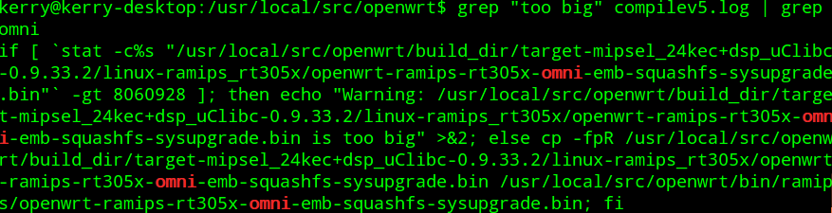

Problems and Solutions

Slide 2
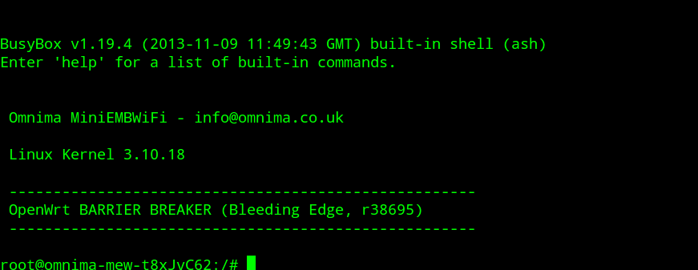
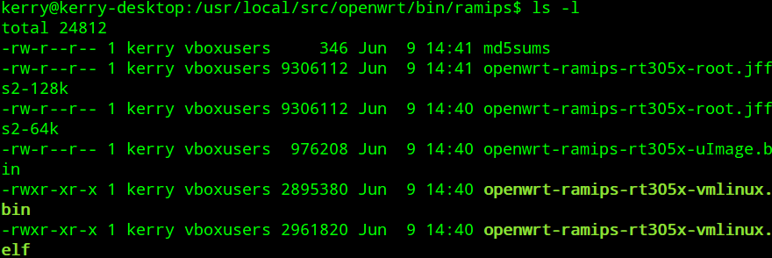

Slide 3
1. Compile/install c and c++ compilers option solved sh(1) no: command not found error and probably would not have relinked /lib/cpp
2. images -gt than sizes being processed complaining that image does not exist in bin/ramips, fixed by cp files from /usr/loca/src/openwrt to /usr/local/src/attitude_adjustment and commented out one line in Makefile
3. Debugged images using u-boot command line -tftpboot bf050000 {name of image file} bootm bf050000 or setting bootfile environment in u-boot, save-env and selecting option 1 from U-boot menu set 57600 8N1 no hardware flow control in minicom and had to install tftp server for u-boot
4. Built omni-emb image using “stable” openwrt distro “Attitude_adjustment” and booted via Ram-got jffs2-scan errors and “old filesystem for new kernel” errors.
5. That is when I knew I had the right image because jffs2 was being mounted instead of squashfs. Reflashed board with new image. Just had to get past “bugs” in attitude adjustment to get to good image, but better than instructions followed in technical overview-i.e. The “Bleeding Edge” distribution

